Slide 1
Variables
Prof. Vishnu Priya P M
Department of Computer Science

Slide 2
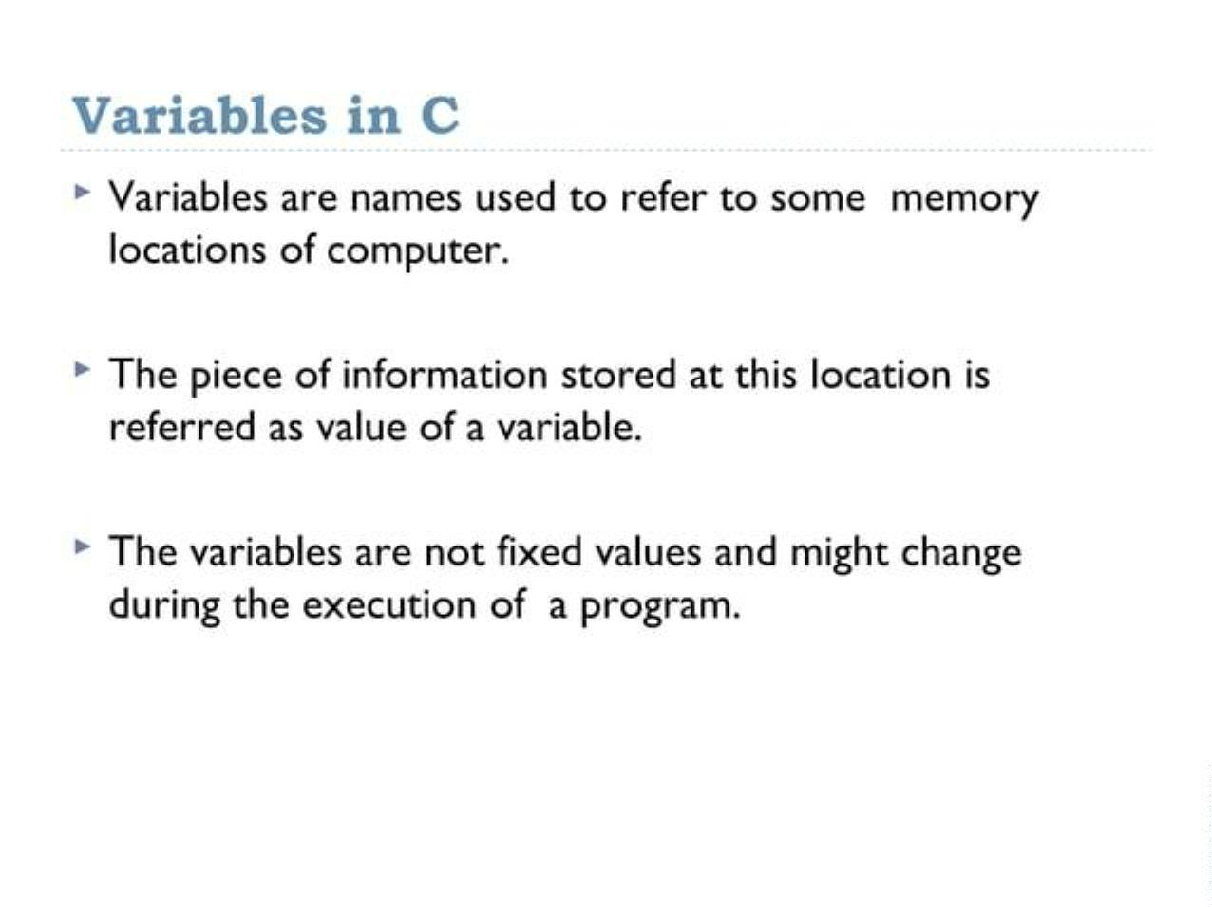

Slide 3
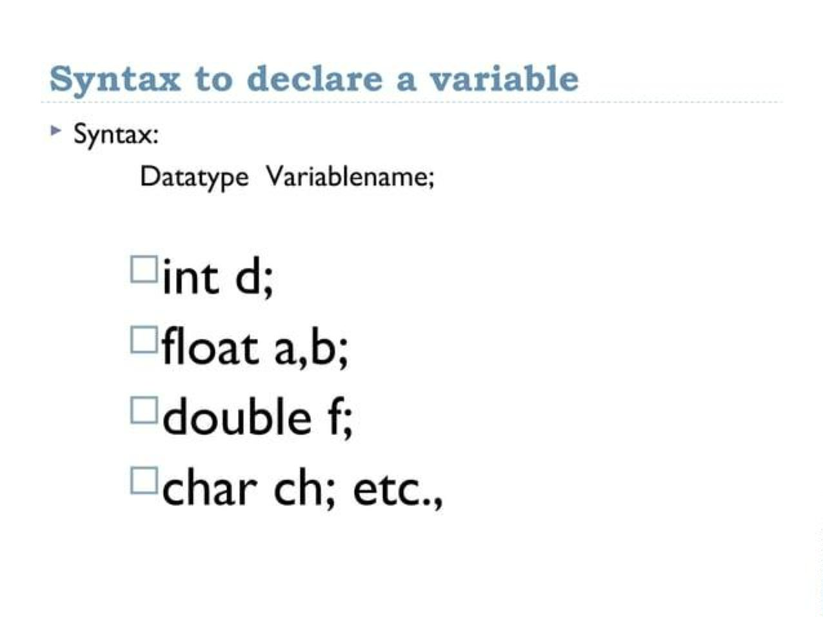

Slide 4
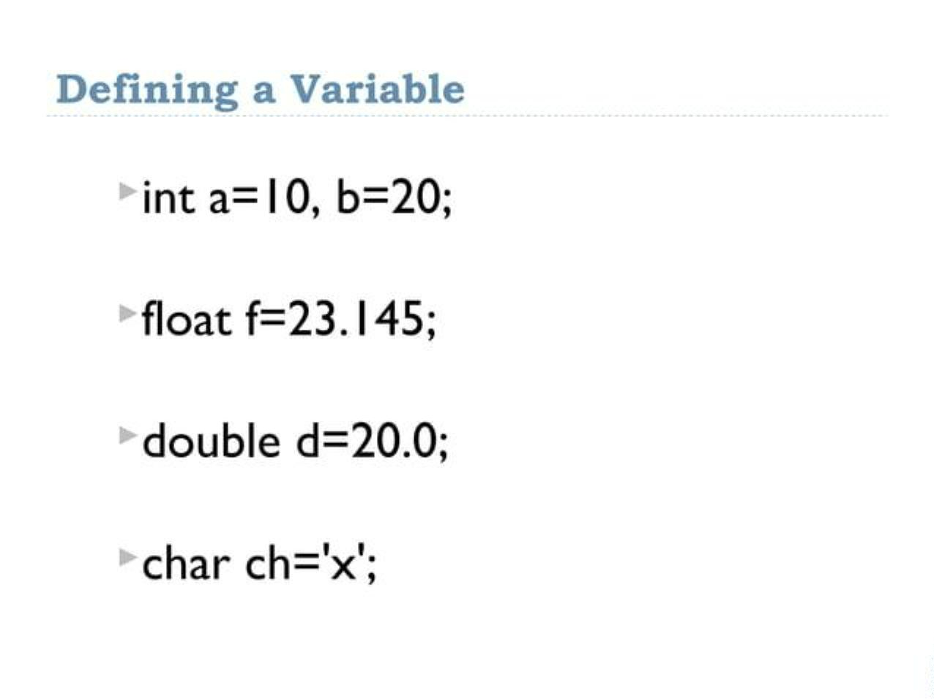

Slide 5
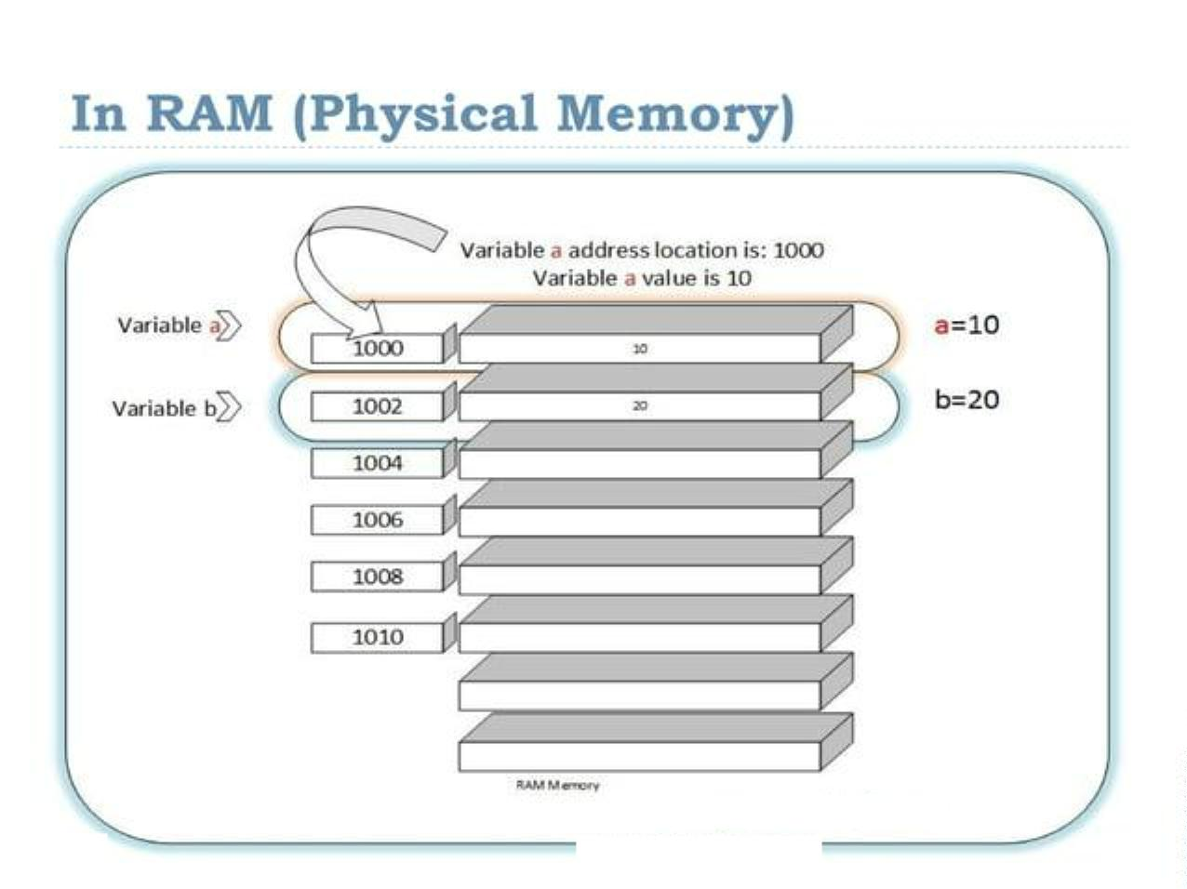

Slide 6
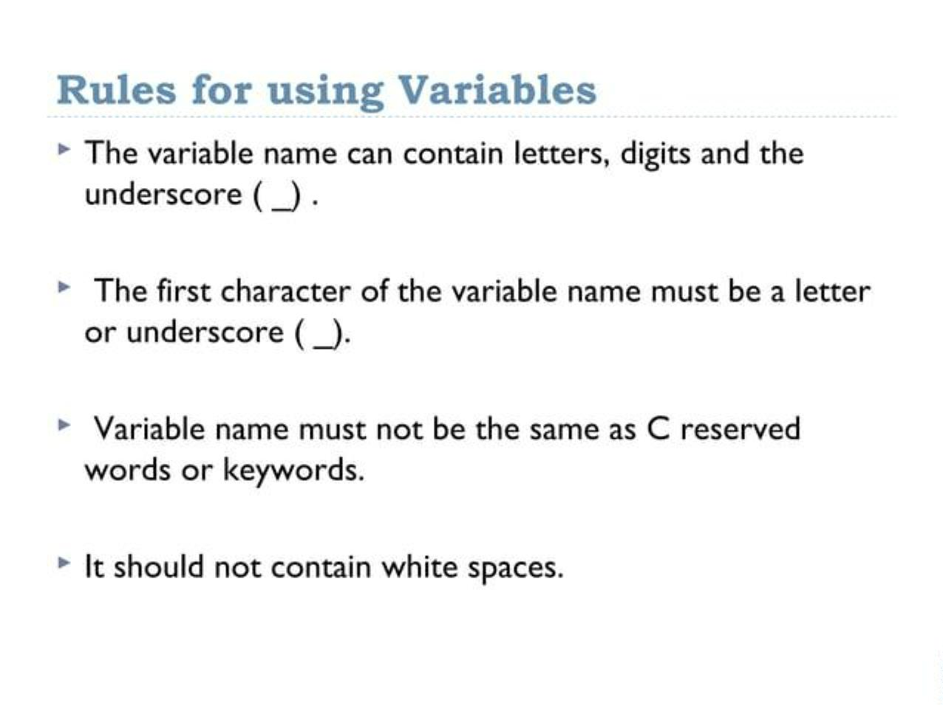

Slide 7
Declaration of Variables in C
In C, a variable must be declared before it is used. The declaration involves specifying the data type of the variable followed by its name. Variables can be declared individually or in groups.
data_type variable_name;
int age;
float salary;
char grade;
Assigning Values to Variables in C
Once a variable is declared, a value can be assigned to it using the assignment operator (=). The assignment can be done either at the time of declaration or later in the code.
Syntax: Example:
variable_name = value;
age = 25; // Assigning value after declaration
float salary = 50000.50; // Declaration and assignment together
char grade = 'A';

Slide 8
Variables
A variable is nothing but a name given to a storage area that our programs can manipulate. Each variable in C has a specific type, which determines the size and layout of the variable's memory; the range of values that can be stored within that memory; and the set of operations that can be applied to the variable.
The name of a variable can be composed of letters, digits, and the underscore character. It must begin with either a letter or an underscore. Upper and lowercase letters are distinct because C is case-sensitive. There are following basic variable types −
Type Description
char Typically a single octet(one byte). This is an integer type.
int The most natural size of integer for the machine.
float A single-precision floating point value.
double A double-precision floating point value.
void Represents the absence of type.

Slide 9
Keywords
Keywords are nothing but system defined identifiers.
Keywords are reserved words of the language.
They have specific meaning in the language and cannot be used by the programmer as variable or constant names
C is case senitive, it means these must be used as it is
32 Keywords in C Programming
auto | double | int | struct
break | else | long | switch
case | enum | register | typedef
char | extern | return | union
const | float | short | unsigned
continue | for | signed | void
default | goto | sizeof | volatile
do | if | static | while

